Slide 1
BlockReward System Logic Flow

Slide 2
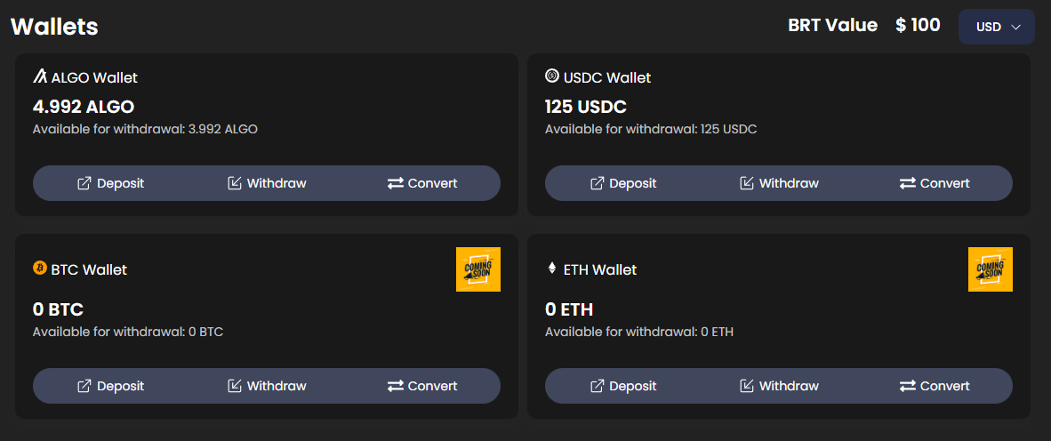
1. Onboarding users to Block Reward using email and phone login and sign up.
We have a custodial wallet system built, so a wallet is ready for users when they sign up for our platform.
Also Users can Deposite and Withdraw their Algo or USDCa from MyAlgo to your Wallet and reverse is possible.

Slide 3
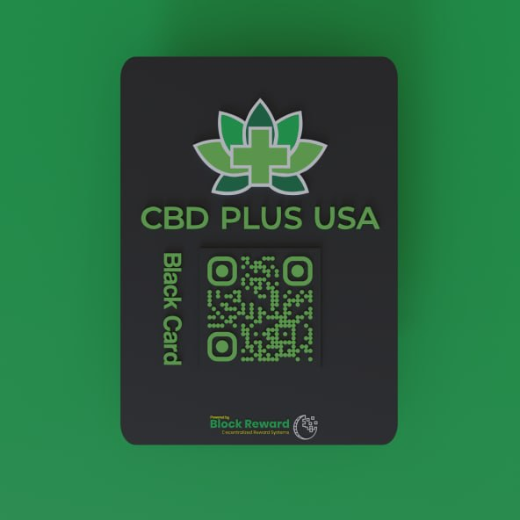
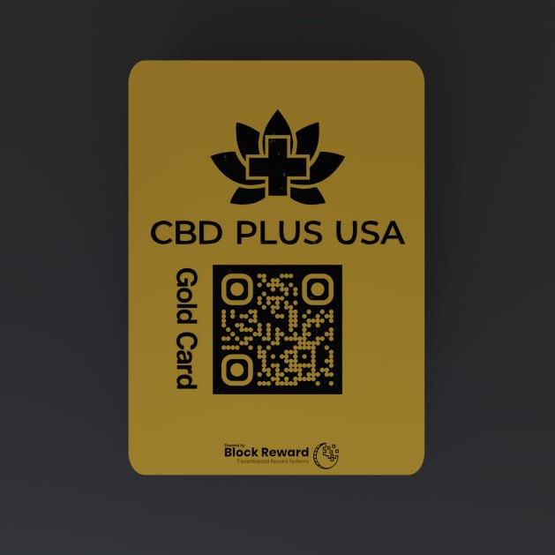
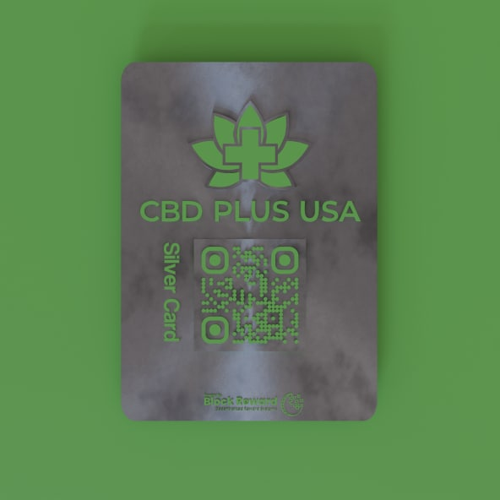
1. Users will buy memberships that are offered by business in our eco
We plan on using Stripe pay for users that want to use CC at checking our on our platform (not yet completed)
We plan on using Claim codes to send to current customers where they would be granted a free membership (Claim code system not completed yet)

Slide 4





Blockchain
Sign Up
Backend
USER
Create wallet for new account
MyAlgo Wallet
MyAlgo Wallet
Algo,usdc
Algo,usdc
Algo,usdc
Users can send and receive Algo and USDC through not only our platform but also MyAlgo Wallet .

Slide 5

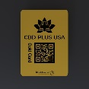

2. User can connect Myalgo Wallet to deposit Algo Or USDCa to upgrade their membership (ARC 19).
If User upgrade their membership, he will get a full-paid Disacount Reedme ,the Best Reward Service.
Algo or USDC for Membership
Algo,USDC for Upgrade
USER
USER
Mint membership
Business Account
Business Account
membership1
Possible for all service
Possible for only service1
Business Reward system 1

Slide 6




3. After a user checks out and buys a product from a business a percentage of that sale is sent to them in BRT(block reward token) EXAMPLE $100 = 10 BRT
Business dashboard enters amount on their end, user scans QR code to receive tokens (working on hardware device) show prototype For now its a tablet with qr code on it
Algorand Blockchain World
Buy a thing cost $100 and showing qr code
(10 BRT)
USER
&
Assistant

Slide 7
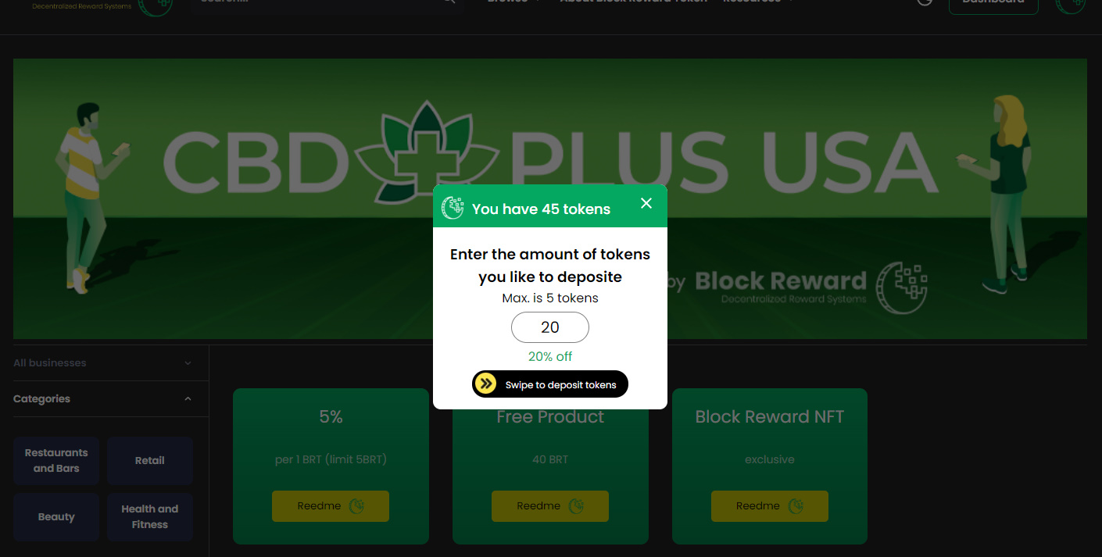
4. Using token to Redeem discounts
User goes to business page and verifies membership(Select the business they want to redeem a discount from)
User chooses a discount option ( up to 25% off 1BRT =5% off) show this action being done from business dashboard
User chooses the mount of BRT they want to use, user swipes to deposit the tokens (smart contract)
A discount code is then sent to their dashboard

Slide 8
4. Using token to Redeem discounts
User goes to business page and verifies membership(Select the business they want to redeem a discount from)
User chooses a discount option ( up to 25% off 1BRT =5% off) show this action being done from business dashboard
User chooses the mount of BRT they want to use, user swipes to deposit the tokens (smart contract)
A discount code is then sent to their dashboard
Algorand Blockchain World
$80 + (4BRT - 20% off) = $ 100
USER
Assistant

Slide 9
If you login BlockReward System You will get the best reward service. Welcome to BlockReward System!

